Slide 1
CANP 1-5 Evaluation
Results, Recommendations and Conclusion

Slide 2
CANP Evaluation
The Capacity and Network Project’ (CANP) started in 2010.
Between 2011-2018 five two-week CANP Workshops and several follow up events have been held: a total of more than 600 participants from more than 25 developing countries in five developing regions in Africa, Asia and Latin America.
In 2015 the ICMI Executive Committee (EC) initiated the evaluation of CANP 1-5. The evaluation aimed to provide input relevant to a decision by the ICMI
leadership regarding the future of the CANP programme series and further
support/activities/action for the five programmes, which are already running.

Slide 3
The five CANP Regions: Geographical Distribution and Key Information

Slide 4
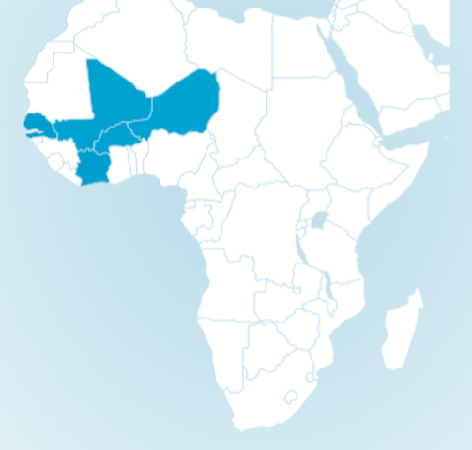
CANP1-EDiMaths: Sub-Saharan Africa/ francophone Western Africa region (started 2011)
^{2011:} CANP-EDiMath1: first workshop was ^{held in Bamako In 2011}
CANP-EDiMaths2: second workshop was ^{held in Dakar, Senegal (2012).}
First workshop had participants from Senegal, Ivory Coast, Burkina, Niger, Mali, Benin. Total: 41, plus organisers.
Selected activities since 2011
Constitution of EDiMATH, a network for the education of mathematics teachers in the sub-region of Western Africa and election of national committee members
Presentation of EDiMaths at EMF 2012 in Geneva
EMF-Algier (2015) laid the groundwork for the Association of African Mathematics Didactics (ADiMA)
Active involvement of CANP participants in activities related to mathematics education (local and regional level): curriculum reform, design, mathematics teacher training programs and mathematics educators.

Slide 5
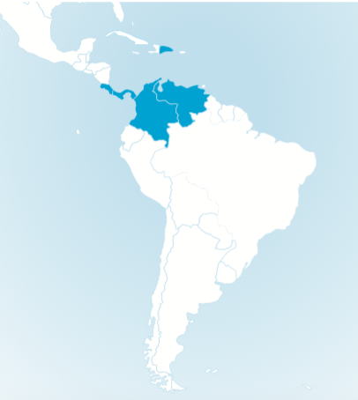
CANP 2 Central America and the Caribbean (started in 2012)
First workshop held in Costa Rica with 43 Mathematics educators from five countries: Costa Rica, Colombia, Panamá, Dominican Republic, Venezuela (plus organisers)
Selected activities since 2011
Founding of the Mathematics Education Network of Central America and the Caribbean. Now members come from 21 countries in Latin America and Spain.
The Congress on Mathematics Education for Central America and the Caribbean (CEMACYC) and the General Assembly of organized by REDUMATE (CEMACYC I, 2013, Dominican Republic, CEMACYC II, 2017, Colombia, CEMACYC III is expected to be held in 2021 in Costa Rica.
The regional report published in English (with Springer) and in Spanish (ICMI website).

Slide 6
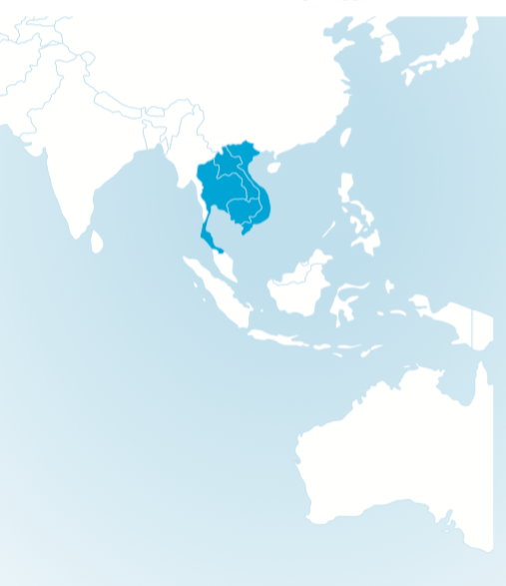
CANP 3 Southeast Asia (Mekong) (started 2013)
The initial Workshop was held 14th–25th of October, 2013 in Phnom Penh, 34 participants came from Cambodia, Laos, Thailand, and Vietnam and facilitators (9) from the region and overseas.
Selected activities since 2011
Participants met in 2015 during EARCOME (Philippines)
CANP meeting in APEC Lesson Study 2015, Thailand
Workshop for Cambodian Teachers- Lesson Study and Open Approach”, 2016, Cambodia
Workshop 2016 at Pakse Teacher Training College, Laos PDR
Open Class (Public Classroom Demonstration), 2017 in Laos
Participation of CANP participants and mathematics educators in various regional and international activities (ICME Hamburg, ICMI Study Conference Macao, EARCOME)

Slide 7
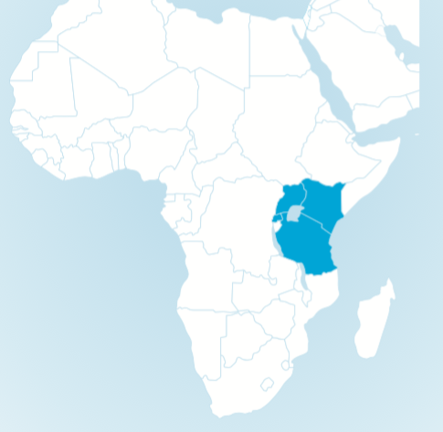
CANP 4: East Africa (started 2014)
First Workshop was held September 1st–12th, 2014 in Dar es Salaam, Tanzania with participants from Tanzania, Kenya, Uganda and Rwanda
Selected activities since 2011:
Creation of regional network of mathematics teacher-educators, collaborating mathematicians, mathematics educators, and mathematics policy-makers in East Africa (East Africa Mathematics Education & Research Network (EAMERN)
Follow up-workshop in 2015 in Rwanda
The Regional report published by Springer „Mathematics Education in East Africa Towards Harmonization and Enhancement of Education Quality“

Slide 8
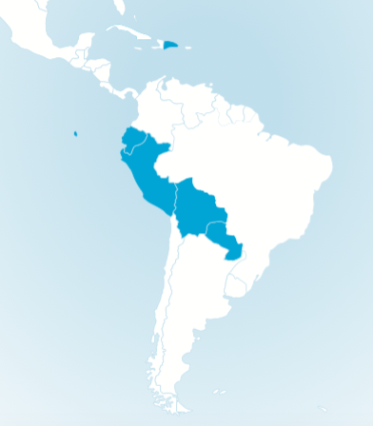
CANP 5 Andean Region and Paraguay (started in 2016)
The fifth Capacity and Network Project Workshop was held February 1 -12, 2016 in Peru. More than 100 participants from Boliva, Ecuador, Paraguay and Peru as well as international scholars from Canada, Costa Rica, France, Italy and the USA.
The workshop was held in Spanish and English consisted of different activities and themes of Mathematics and Mathematics Education.
A follow up meeting and constitution of a Mathematics Education Network in the region 2017 in Ecuador.

Slide 9
CANP Evaluation Design and Methods:
The CANP Evaluation was based on quantitative and qualitative data using a combination of online surveys, a 3-hour Discussion Group meeting with participants during ICME 13 and reports and data from the workshops (desk study).
Summary about the two SURVEYS:
Survey 1: Target Group: CANP Participants from all 5 CANP regions:
71 Total Responses from 250 participants of the five workshops,
January 27, 2016- July 1, 2016
Survey 2: Target Group: Organizer from all 5 CANP regions:
20 Total Responses from IPC, Program Manager, Local Chair (total 45)
March 22, 2016- July 12, 2016
Note. Presentation is a small selection of data—full report is published on the ICMI website.

Slide 10
CANP Evaluation Criteria
The CANP evaluation assessed the results of CANP according to the five evaluation criteria used by OECD/DAC: relevance, effectiveness, efficiency, impact and sustainability (OECD/DAC, 1991).
Is CANP 1-5 consistent with the needs and priorities of its target group and the policies of ICMI? (Relevance)
Has CANP 1-5 achieved its objectives or will it do so in the future? (Effectiveness)
Can the costs of CANP 1-5 be justified by the results? (Efficiency)
What are the overall results of CANP 1-5 (2010-2015)? (Impact)
Will the benefits produced by CANP 1-5 be maintained after the cessation of external support?
What is the future of the CANP programmes and its created networks? (Sustainability)

Slide 11
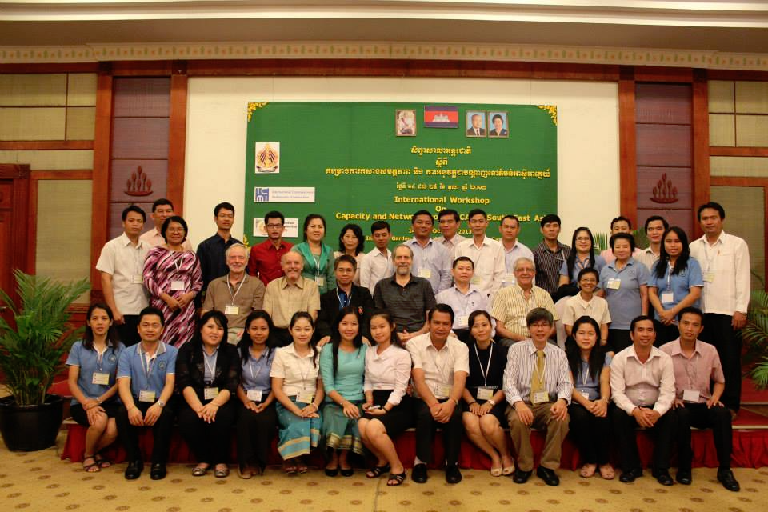
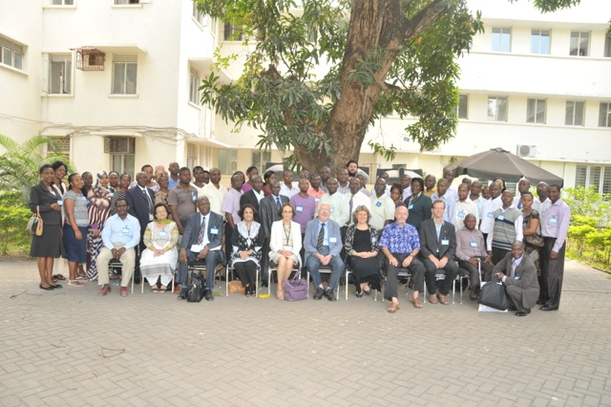
Relevance
Is CANP 1-5 consistent with the needs and priorities of its target group
and the policies of ICMI? Was the workshop useful for the participants? (Relevance)?

Slide 12
Key Results: Relevance
The results of the evaluation indicate that the content is scientifically relevant and the participants mention that they are using the teaching methods learned and CANP has improved their mathematical and pedagogical expertise.
They also would like to participate in follow up activities. They are willing to help to organise follow up activities as they see CANP as a relevant tool for their professional development and capacity building.

Slide 13
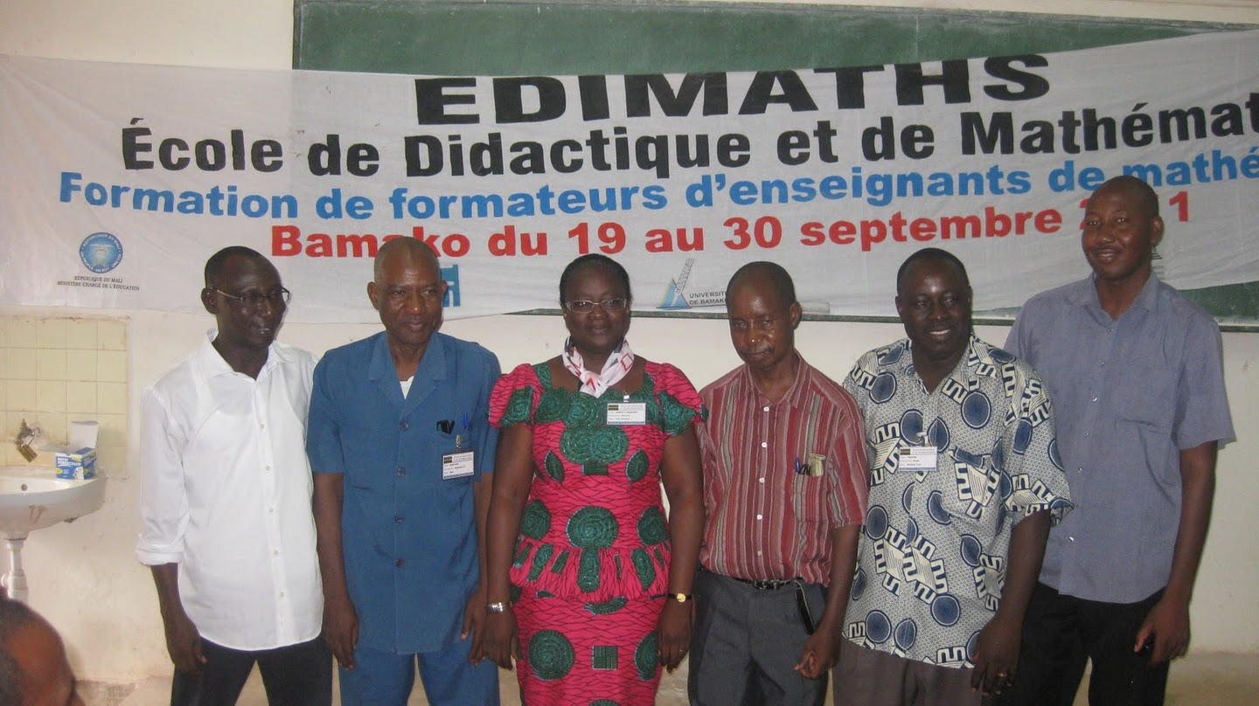
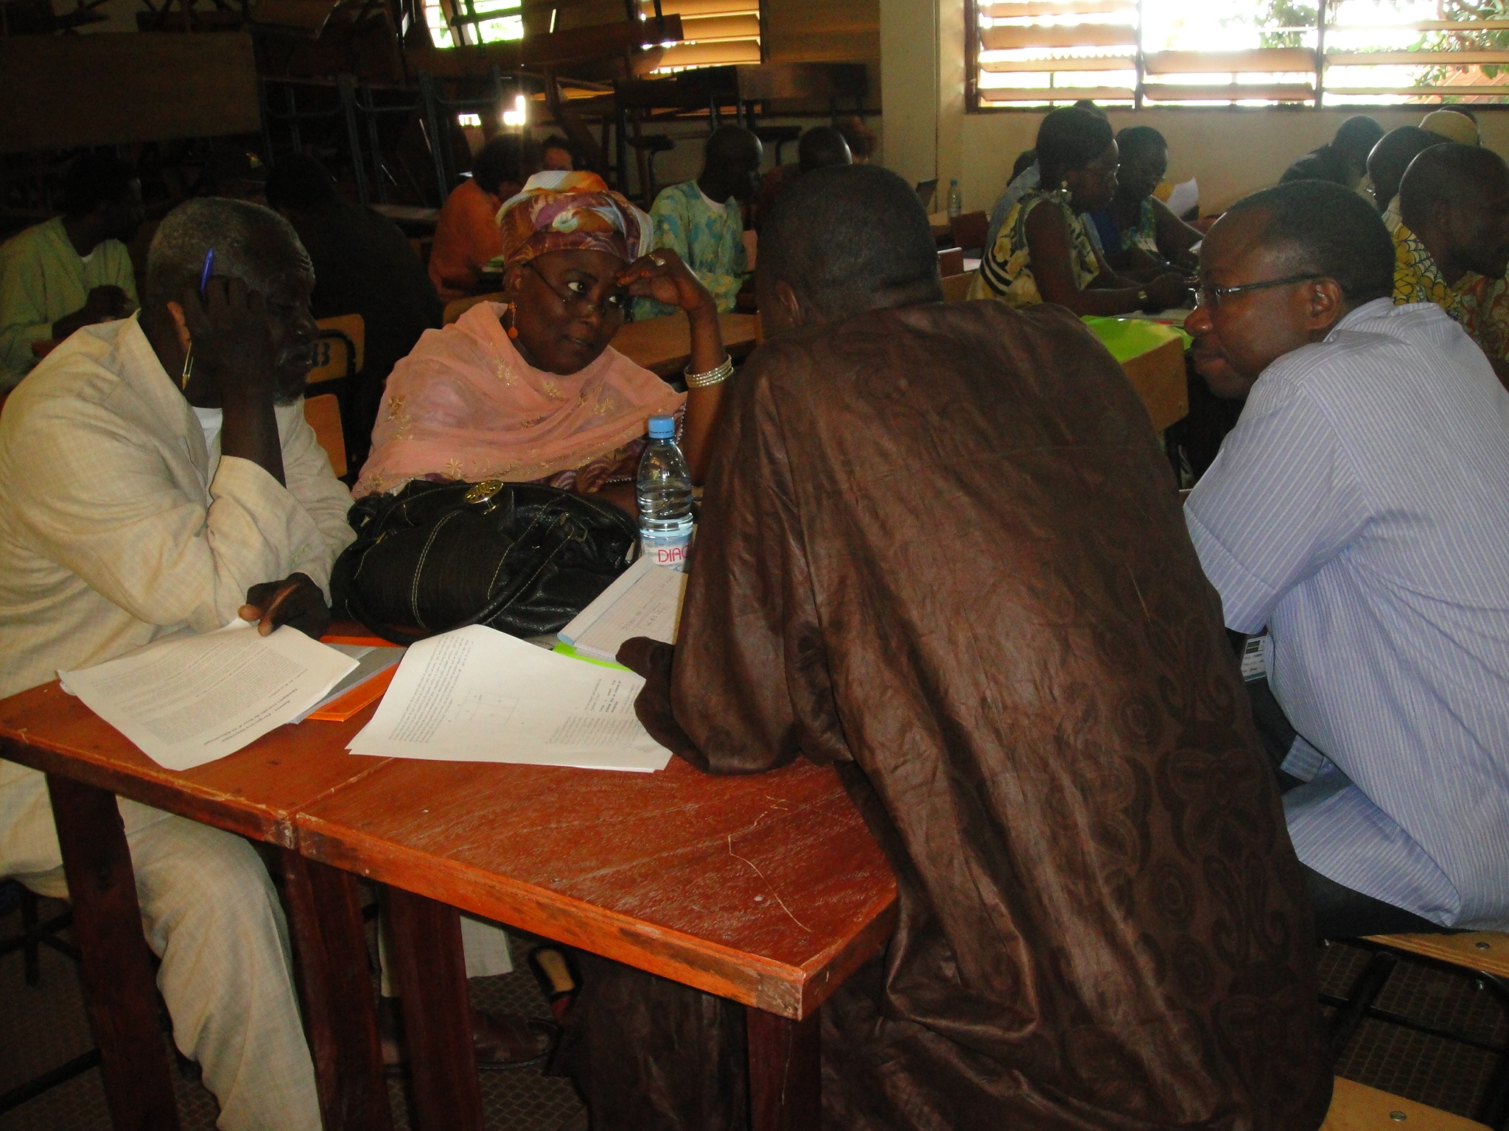
Effectiveness
Has CANP 1-5 achieved its objectives or will it do so in the future? (Effectiveness)
CANP Mali

Slide 14
Effectiveness
All five CANP regions have created a regional networks:
EdiMath
Mathematics Education Network of Central America
and the Caribbean (REDUMATE),
Mekong Network
East Africa Mathematics Education and Research Network (EAMERN) and
Comunidad de Educación Matemática de America del Sur (CEMAS)
The networks have organised follow up meetings and regional
activities and visits.
CANP Mali

Slide 15
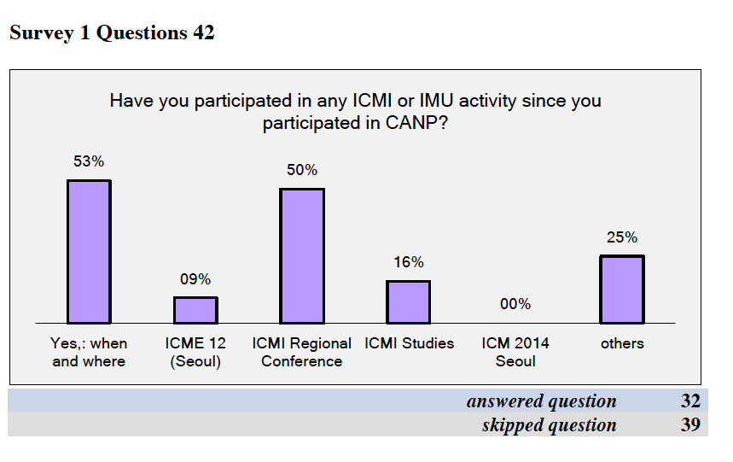
Effectiveness
The survey answers from the participants from CANP 1-4 show that participants use the regional reports and some have participated in further ICMI or IMU activities.
In particular, they have participated in
ICMI Regional Conferences where
they could meet more members of the
regional mathematics educator
community.
CANP Mali

Slide 16
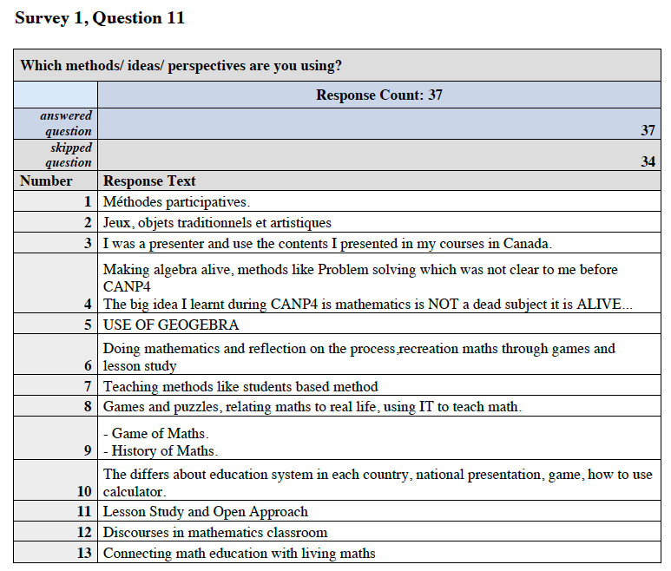
Effectiveness
CANP also helped participants to improve their knowledge about lesson planning and various teaching techniques.
Some participants got inspired to continue their own training/education: for example, one participant is now (2016) doing a PhD in Math Education following ideas the participant got from CANP, another participant got inspired to complete a MSc. Thesis.
CANP Mali

Slide 17
Effectiveness
The activities of the newly established CANP 1-5 networks show that CANP is a useful tool to initiate regional networking and foster capacity building for mathematics educators.
Most networks would need further support to gain strength and impact in their regions.
The CANP participants assessed that CANP 1-5 had fruitful collaborations with various regional organisations and institutions that should be deepened. The participants also agreed that it was important to collaborate with organisations and institutions already existing in the region CANP is held or nearby countries.
CANP Mali

Slide 18
Effectiveness: Recommendations for Regional Networks
The following recommendations should be considered by the ICMI leadership:
The regional networks are still young and in a development state and would benefit from further support from ICMI leadership and ICMI community members. It does not necessarily have to be financial support, but further involvement (support of capacity building) in the regions through ICMI leadership and the ICMI community.
Possible examples for financial support could be basic support for infrastructure for the regional networks and support for follow up activities.
The members of the CANP 1-5 network should regulary be informed about and involved in ICMI activities like ICMI publications, ICMI conferences, in ICMI committees etc.)
CANP Mali

Slide 19
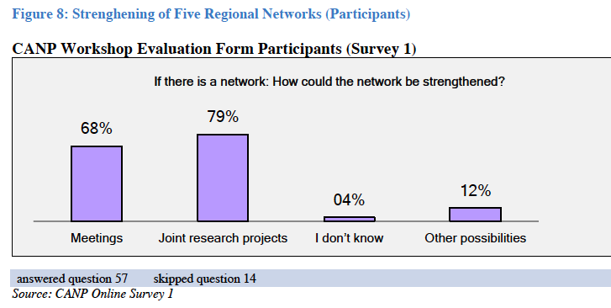
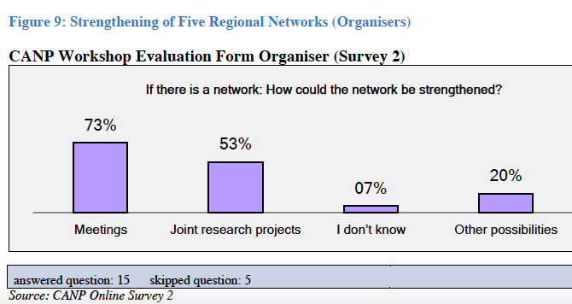
Effectiveness
Support for joint research projects is seen by participants and organisers as a factor to strengthen and to develop the network.
While participants favoured joint research projects as a tool to strengthen the network, the organisers favoured first meetings and then joint research projects.
CANP Mali

Slide 20
Recommendation: Research
ICMI could to identify complementary programmes to strengthen joint research cooperation (regionally and internationally) and involve the network members in joint research activities.
Basic funding for research in mathematics education in the context of development cooperation and options for a flexible approach could be discussed with the ICMI leadership & the networks.
Possible programmes could be short time research sabbaticals for mathematics education (e.g. like the IMU CDC “Abel Visiting Scholar Program” but the targeting mathematics educators).
The participation of five CANP participants in the ICMI Study 23 Conference in Macao 2015 was seen as a very effective tool for them to get involved in research activities. This option/tool should be considered for further ICMI Studies and other ICMI research activities.
During the CANP Discussion Group it was also mentioned by one local organiser to consider launching regional research activities: e.g. an ICMI Regional Study.
CANP Mali

Slide 21
Effectiveness: Further Recommendations
Involving ICMI Representatives, ICMI Regional Conference organisers, ICMI Affiliated Study Groups and Organisations in the new networks and in CANP activities (for example through CANP meetings and activities during CMI Regional Conferences) could also be a useful tool to strengthen the five existing CANP regions, its networks and members.
The role of regional mathematics education organisations and in particular ICMI Affiliated Organisations like IACME should be considered.
Strengthen the cooperation between ICMI/CANP networks with existing cooperation partners and networks: establishing a closer connection between ICMI and IMU-CDC and connecting to existing mathematical bodies and organisations (for example AMMSI, AIMS and the African Mathematical Union in Africa).
Strengthen links between the newly established networks with institutions like UNESCO; JICA and local ICSU offices.
CANP Mali

Slide 22
Effectiveness: General Observation
The general observation regarding criteria ‘effectiveness’ that can be drawn from
the survey answers and the answers in the discussions with participants and
organisers is that the CANP workshops provided a platform for capacity and
network building for participants and that CANP 1-5 has met the original aims
and goals.
CANP 1-5 contributed to the growth of regional professional communities and has initiated a process to foster regional development in the field of mathematics education in the regions CANP took place.
CANP Mali

Slide 23
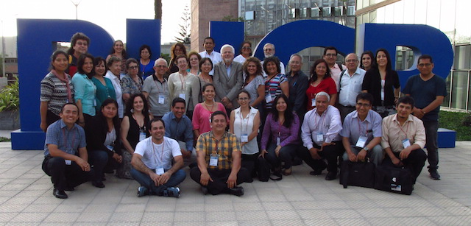
Efficiency
Can the costs of CANP 1-5 be justified by the results? (Efficiency)
CANP Peru 2016

Slide 24
Efficiency
The assessment of cost/benefit ratio focused on the cost for ICMI and the funds ICMI received directly from donors for CANP for the two-week CANP workshop and the first follow up event after 1-2 years. Locally fundraised support and paid costs had no impact on the ICMI budget.
On average the total cost per CANP 1-5 two-week workshop with 40 full-time participants and one follow up meeting with fewer participants including local funds was between €40.000 - €80.000.
CANP Peru 2016

Slide 25
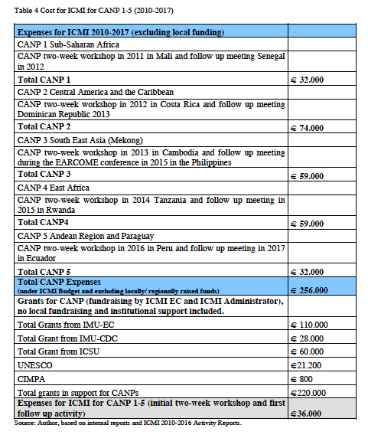
Efficiency
ICMI and the local organisers were very successful in raising local, regional and international funds and of the CANP costs where covered by external funds and grants and ICMI spent from its annual budget about €36.000 for all five (!) CANPs initial two-week workshop and the first follow up meeting.
The cost for ICMI was approx. €180 per CANP 1-5 participant of the first initial two-week workshop and the follow up activity. The total cost per participant including regional & local funding) for the first initial two-week workshop was approx. €800 (for local participants) – €2000 (for regional participants) very low.
CANP Peru 2016

Slide 26
Efficiency
Almost all local administrative cost was covered from other sources (e.g. the local universities, employers) and/ or the work was done during free time of those individuals.
On average only €1.000 was spent from ICMI funds for administration per CANP workshop.
All five CANPs were organized on a very high level. The survey and reports show that the organisers were very highly motivated and dedicated many (voluntary) hours into CANP. None of them received (as far as it could be assessed) any direct honorarium for their time
and efforts spent on CANP.
The administrative workload is very high for each CAN. No CANP could have happened without the extraordinary work by many people who have put in countless hours to make each CANP a success.
It must be considered for each new CANP programme that a pool of local volunteers have to be available to manage all logistical, administrative and scientific duties.
CANP Peru 2016

Slide 27
Efficiency: Recommendation
It could be considered for future CANPS to involve the national contact people in the development of the scientific programme. This would allow more input regarding the direct needs of the participants. This was also requested in the surveys.
Another issue is the agreement with the local organisers and ICMI: ICMI could consider developing a set of CANP guidelines and/or policies of the role of the local organisers and local chair including issues like scientific programme, fundraising, amount of support from ICMI, selection of participants, reports etc. to avoid misunderstanding.
This should be part of an agreement between ICMI and the Local Chair/host institution. It could be quite basic and be modelled on the contract with ICME organisers.
CANP Peru 2016

Slide 28
Efficiency: General Assessment
The general assessment regarding ‘efficiency’ of CANP 1-5 can be rated as very good.
Due to fundraising the cost for ICMI remained very low.
The administrative workload was quite high for all stakeholders and has to be considered when planning new CANP Programmes and activities.
CANP Peru 2016

Slide 29
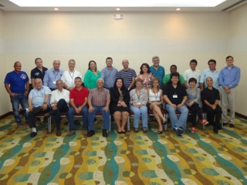
Impact
What are the overall results of CANP 1-5 (2010-2015)? (Impact)
CANP Costa Rica and follow up

Slide 30
Impact for participants
The results show that the participants valued in particular that they
learned new teaching methods and topics and improving teaching methods;
established regional networks and started to cooperate with colleagues from home country and the region;
learned about assessment of teaching and learning in the classroom;
have a better understanding of learners behaviour;
started to implement research activities;
have more interest in research and reflection of teaching;
started to reflect the mathematics education system.

Slide 31
Impact on the organisational level
Due to the short time since CANP started it could not be answered if (and how much) the training and capacity building of the individuals who participated in CANP has a larger impact in the participating countries and what is the impact of CANP on the organisational level.
A collection of best-practice examples (and possibly a vision/ guideline) how individuals can have an impact in their institutions could increase the general impact of CANP.
How to integrate the newly learnt qualification might be a topic to discuss in further CANP meetings e.g. using best –practice examples.
It this context it should be considered to have for future CANP activities a formal/informal agreement between ICMI and the home institutions of the individuals who participate in the CANP workshops about CANP and its benefit for the individuals and home institutions.

Slide 32
Impact on policy level
The CANP programmes 1-5 tried to raise public awareness through public outreach activities like lectures for teachers, involvement of policy makers in the workshops (e.g. during opening and closing ceremonies) and mass media (TV and Radio coverage of the workshops) but at this point of time an assessment of the policy impact is not possible.
The networks and ICMI should consider reaching out to policy makers and politicians in developing countries to raise the awareness of the importance of mathematics education and provide further legal, financial and administrative support to sustain the newly established networks.
Many participants of the CANP Discussion Group during ICME 13 in Hamburg agreed that it could become an activity of the ICMI leadership and community to reach out to politicians and policy makers in developing countries.

Slide 33
Impact: General Assessment
The assessment of impact shows that CANP has made a real difference to the
participants and other beneficiaries. More than 600 people (2011-2018) were directly affected through CANP activities and especially those who participated in the two-week
workshop (approx. 200) and teach either in university or school affect in total
several thousand students through their new teaching methods and knowledge
about teacher education issues and practices.
CANP contributes to the achievement of overall objectives of ICMI to improve the quality of mathematics teaching and learning worldwide and to promote the collaboration, exchange and dissemination of ideas and information on all aspects of the theory and practice of contemporary mathematical education.
If the new networks keep growing and active, an impact on the regional development of mathematics education in the CANP regions can be assumed.

Slide 34
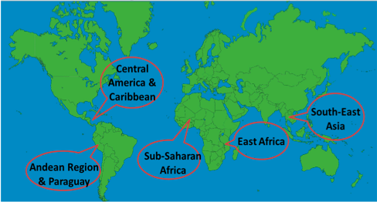
Sustainability: Future of five existing CANP regions and new CANP programmes
How should/could existing CANPs be further supported? What is the sustainability of CANP?

Slide 35
Sustainability: Expected sustainability at individual level
Most participants would like to participate in a follow-up, more advanced workshop.
82% of the respondents of the survey would like to help organizing follow up activity.
But 67% (30 respondents ) mention that they would need some financial
support for a follow up meeting. 78% (35) think that their home institution would be
interested to host/ support/organize a follow up workshop.
On the other hand, the reports and discussion with both, participants and organisers show that it is difficult for many participants to sustain CANP results on an individual level- for
example to stay active in the network and to help organising follow up meetings.
Further involvement and support in the five regions would be necessary to sustain the results on an individual level and help the participants of the workshops to become facilitators in their regions

Slide 36
Sustainability: Expected sustainability at an organisational level
The list of activities and events listed in the Evaluation ‘CANP in Detail’, show that there are significant number of CANP 1-5 follow up activities. They demonstrate the motivation of the participants to sustain the work of CANP in building capacity in mathematics teaching.
The activities also demonstrate a strategic range in the outreach and networking as they
go from the local to regional and then international.
If sustained through regular support/mentorship from senior mathematics educators and
mathematicians, and adequate resourcing, the networks could become a thriving node
for mathematicians and mathematics educators in the five CANP regions.
Therefore, it is recommended that the ICMI leadership considers developing a policy and strategy for the CANP regional networks and how to integrate them into the ICMI Structure. Also a strategy plan for CANP (1-5) but also new CANP programmes could be discussed with the stakeholder and be ratified by the ICMI EC.

Slide 37
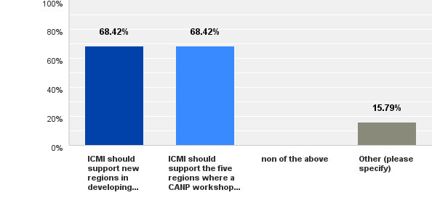
Sustainability: Support for CANP 1-5 or CANP 6+
Almost 70% of the respondents from survey 2 (organisers) suggest that ICMI should support new regions in developing countries to held a CANP workshop. The same number (70%) suggests that ICMI should support the five regions where a CANP workshop has been held.

Slide 38
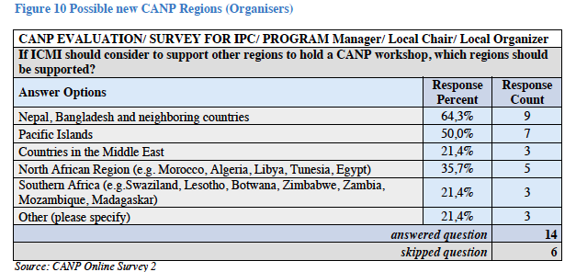
Sustainability: New CANP Regions
In case ICMI decided to support new regions, the following three regions received the highest approval rate for getting supported: Nepal, Bangladesh and neighbouring countries, Pacific Islands and North African Region.

Slide 39
Sustainability: Recommendations
The following recommendations regarding sustainability are given:
As a key result from the evaluation it is suggested that ICMI should support both: new CANP programmes (in new regions) AND the existing (CANP 1-5) programmes. Developing and enhancing the mathematical and pedagogical potential of a region takes several years, therefore it is recommended to continue the involvement in the CANP 1- 5 regions.
A strategic plan from ICMI/ ICMI leadership how to continue support (e.g. mobility and technical) for the five networks would help to sustain achieved results.
An extension of the financial and international support for CANP 1-5 activities would help to establish a sustainable structure/network in the five CANP regions and possibly allow to extend each region with more participating countries: For example CANP 3 could involve Myanmar, CANP 4 could reach out to neighbouring countries as well as to CANP 1, and CANP 5 could (continue) to reach out to CANP 2. For CANP 1 also the extension to close countries should be envisaged (Cameroon, Congo).

Slide 40
Sustainability: What could be the future of the CANP series in general and ICMIs role in it?
The five networks should be involved in any ICMI regional activities, e.g. Regional Conferences, ICMI Studies, at ICME, in regional meetings or activities from ICMI Affiliated Organisations and Study Groups. This could ensure the actual “empowerment” of the five regions and help the CANP participants to become more active in the ICMI community, at the same time, local ownership of the networks and its activities must be ensured.
Monitoring structures of the CANP 1-5 (and future) CANP network activities and of possibly third-party funding should be considered, e.g. annual reports by the network to ICMI leadership.
The structures of the five regional networks should be discussed with the ICMI leadership, e.g. should the ICMI leadership support a basic structure e.g. with at least one contact person per country and one main contact person for the entire network.

Slide 41
Sustainability: General Assessment
The assessment regarding sustainability is positive on the individual level.
There is a high interest of many participants to sustain the results of CANP and to keep active in the new network to improve mathematics education in the region.
At the organisational level the results show that the new networks need further support and strategies to sustain their impact and the results of CANP.
Many networks also depend heavily on a few individuals.
The evaluation shows that the networks and projects initiated through CANP can be sustained at a certain level in the future, but further support and some basic funding for activities of the network for at 2-5 years would be helpful to involve more stake holders in the networks and help to sustain them.

Slide 42
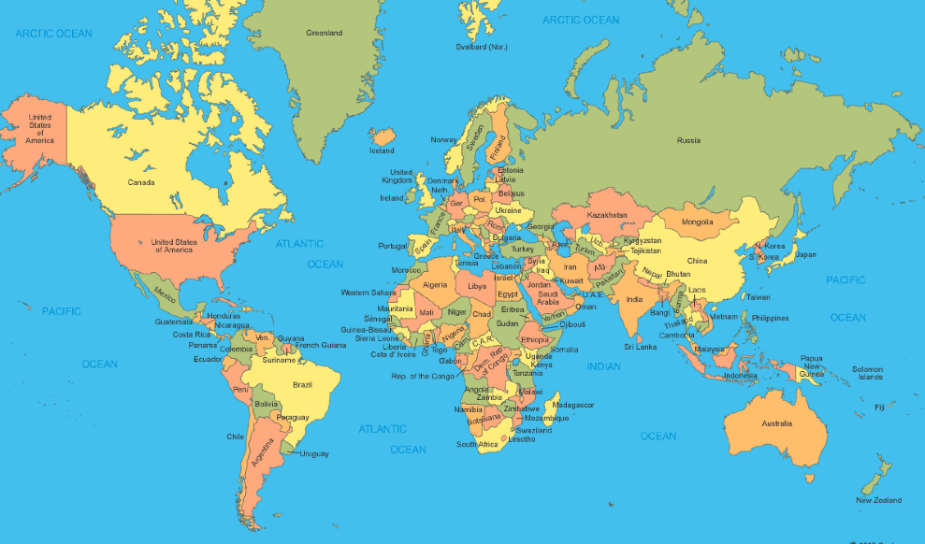
Key Results: Future of the Capacity and Network Project (CANP)
Further Recommendations and Conclusion

Slide 43
Further Recommendations
Communication and cooperation within the regional network, but also between the five
networks and other ICMI stakeholder/community members should be intensified, e.g.
through social media and new technologies. WhatsApp, Telegram, or Facebook groups can help spread news and keep in contact.
Members of the East African Mathematics Education Network created short videos for learning and distributed those videos via WhatsApp.
The CANP 2 Mathematics Education Network of Central America and the Caribbean network has an active Facebook Page.
The CANP 5: the creation of an WhatsApp group facilitated easy and free exchange of information and was used as a tool to distribute information about the follow-up activities in 2017.

Slide 44
Further Recommendations
The issue of regional (scientific) relevance should be monitored in all CANP
activities very strongly, regional related topics should be included in all activities.
Clearly defined monitoring and evaluation structures including defining clear
objectives, results and indicators for measuring the success for each new CANP activity
should be taken into consideration by the ICMI leadership, but also by involved local
organisers when planning any new CANP activities.

Slide 45
Further Recommendations
Funding for research and infrastructure is seen as a factor which can sustain the newly created regional networks.
ICMI EC should consider an extension of some basic financial and international support for CANP 1-5 activities for five years which would support the development of a sustainable structure/network in the five CANP regions.
The involvement of CANP participants in ICMI Regional Conferences could be supported (via fundraising from ICMI and/or travel fellowships (e.g. Solidarity Fund Grants from the Registration Fee at Regional Conferences).
ICMI EC and ICMI representatives could be involved in CANP fundraising activities.
Best practices how to fundraise locally should be monitored by the ICMI leadership and shared with the five networks.

Slide 46
Further Recommendations
As a result from various discussions with stakeholders during the evaluation process,
the following ideas for further activities to support developing countries should be
considered and discussed by the ICMI leadership:
consider the creation of a database for mathematics educators worldwide- this would help mathematics educators or other people interested in the field to find each other for research and/or cooperation projects.
Establish summer schools for early career scholars as a tool for regional development. Those could be organised with the help of the CANP regional networks and could be modelled on the CANP workshops and CIMPA schools.

Slide 47
Conclusion
CANP fulfilled its aims for which it was created
General satisfaction of the first five CANP programs by the the participants and organisers.
CANP 1-5 contributed to improving the individual scientific capacity of the participants and supported network building.
The visibility of ICMI is expected to increase with the growing of the regional networks.
There is an interest (by the CANP organizers as well as members from the ICMI community from developing countries) to initiate new CANP programs, but also the five existing networks/ regions request further support.

Slide 48
Conclusion
As a final conclusion it can be stated that CANP 1-5 is a successful development instrument, which fosters regional capacity building and network development in mathematics education in the participating developing countries.
At the same time the evaluation shows that there is still work to be done to sustain the results the CANP workshops achieved and to foster the newly established regional networks and the individual members.
If funding and human resources are available further support for CANP is recommended.

Slide 49
In case of further questions, please contact
Lena Koch
Lena.koch@wias-berlin.de

